Slide 1
Descriptive Statistics

Slide 2
LO
Find numeric summaries of data; describe data using stem-and-leaf diagrams, frequency distributions, histograms, time series plots.
Determine quartiles and construct the box plot for a data; identify outliers.

Slide 3
Introduction
Population
μ, σ², σ, etc.
(parameters)
Numerical summaries
‾x, s², s, etc.
(statistics)
Sampling
Inferential statistics
Estimation,
Hypothesis testing, …
about parameters of population
Sample
Descriptive Statistics
Displays
(stem and leaf, histogram, box plot, etc.)

Slide 4
Simple descriptive statistics
population
measure the average value
•
Sample mean
measuring the central value
Median, quartiles
•
sampling
•
•
x₁
x₂ x_{n}
•
Sample variance
Sample standard deviation
A sample data x₁, x₂, . . . , x_{n} has been collected
Sample range
Quantile
measure the variability and spread of data

Slide 5
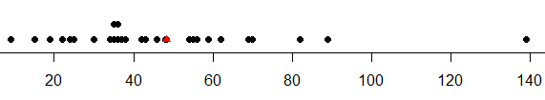
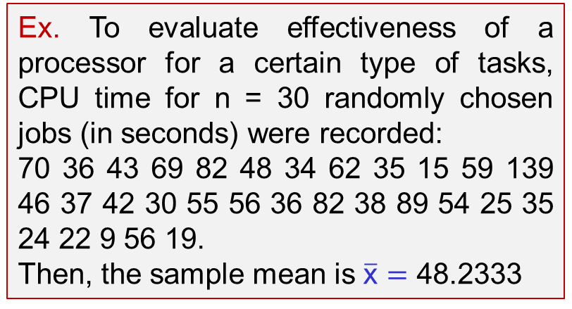
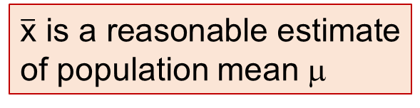
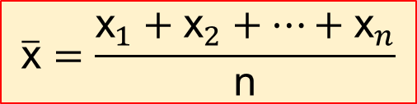
Sample Mean
$$\overline{\text{x}}=\frac{{\text{x}}_{1}+{\text{x}}_{2}+…+{\text{x}}_{n}}{\text{n}}$$
$\overline{\text{x}}$ is a reasonable estimate of population mean μ
the location or central tendency in the data
Sample
Mean
does not convey all of the
information about a sample of data
Ex. To evaluate effectiveness of a processor for a certain type of tasks, CPU time for n = 30 randomly chosen jobs (in seconds) were recorded:
70 36 43 69 82 48 34 62 35 15 59 139 46 37 42 30 55 56 36 82 38 89 54 25 35 24 22 9 56 19.
Then, the sample mean is $\overline{\text{x}}=$ 48.2333
can be thought of as a “balance point” in a dot diagram
Notes:
x<-c(70, 36, 43, 69, 82, 48, 34, 62, 35, 15, 59, 139, 46, 37, 42, 30, 55, 56, 36, 82, 38, 89, 54, 25, 35, 24, 22, 9, 56, 19)
y<-c()
y[1:30]<-0
y[2]<-0.2
y[9]<-0.2
plot(x,y,ylim=c(0,10),pch=19)
p<-mean(x)
q<-0
points(p,q, pch=17, col=‘red’)

Slide 6
Ex
(Ex.6-38) The female students in an undergraduate engineering core course at ASU self-reported their heights to the nearest inch. The data follow. Calculate the sample mean.
62 64 61 67 65 68 61 65 60 65 64 63 59 68 64 66 68 69 65 67 62 66 68 67 66 65 69 65 69 65 67 67 65 63 64 67 65
---
n = 37
The sample mean is‾x = (∑x_{i})/n = 2411/37 = 65.16
Notes:
x<-c(62, 64, 61, 67, 65, 68, 61, 65, 60, 65, 64, 63, 59, 68, 64, 66, 68, 69, 65, 67, 62, 66, 68, 67, 66, 65, 69, 65, 69, 65, 67, 67, 65, 63, 64, 67, 65)

Slide 7
x₁ x₂ ………… x_{k}
n₁ n₂ ............. n_{k}

Slide 8
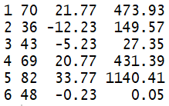
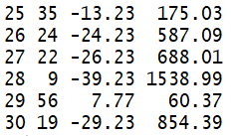

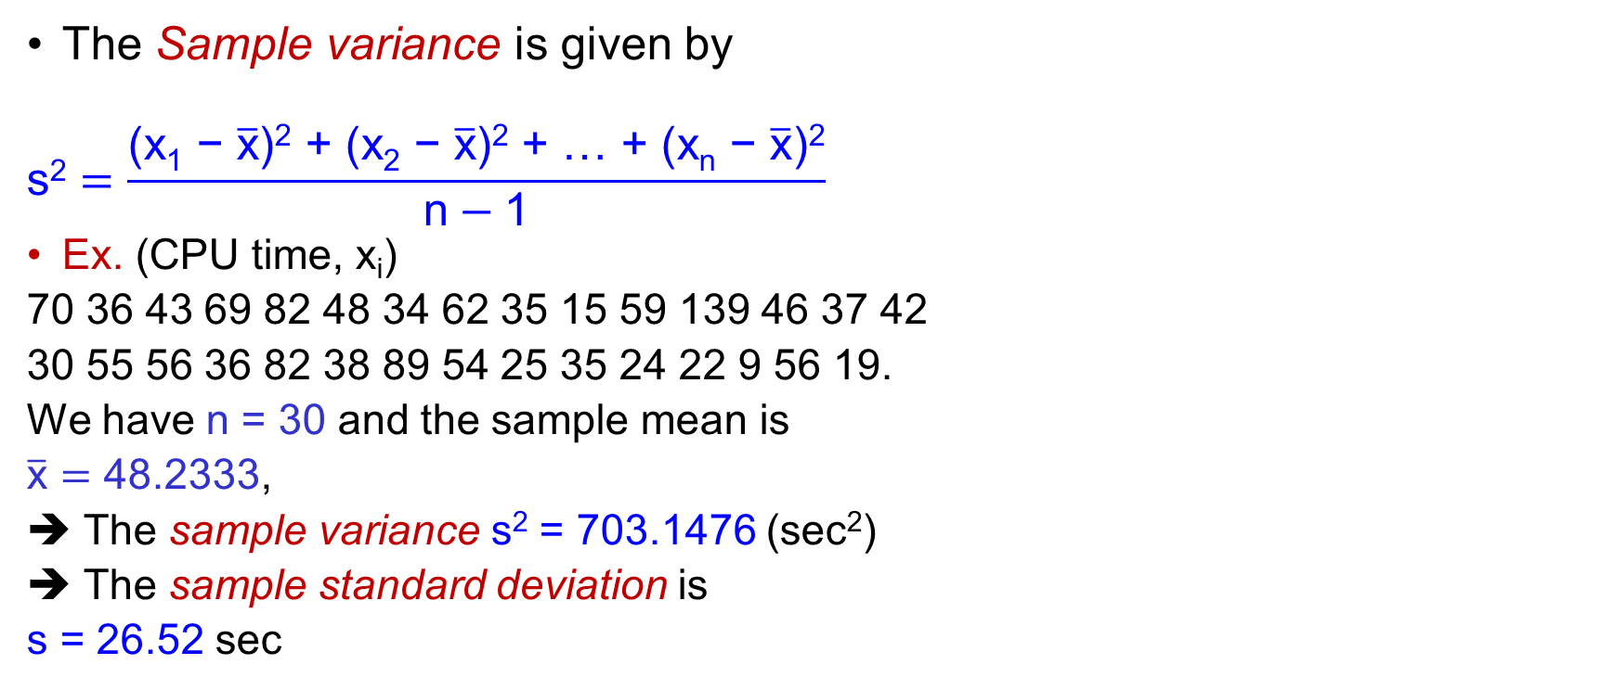


Sample variance
x_{i} (x_{i} - $\overline{\text{x}}$) (x_{i} - $\overline{\text{x}}$)²
The Sample variance is given by
$$\text{s}\text{2}=\frac{\text{(}\text{x}\text{1}\text{ − }\overline{\text{x}}\text{)}\text{2}\text{ + (}\text{x}\text{2}\text{ − }\overline{\text{x}}\text{)}\text{2}\text{ + … + (}\text{x}\text{n}\text{ − }\overline{\text{x}}\text{)}\text{2}}{\text{n}−\text{1}}$$
Ex. (CPU time, x_{i})
70 36 43 69 82 48 34 62 35 15 59 139 46 37 42
30 55 56 36 82 38 89 54 25 35 24 22 9 56 19.
We have n = 30 and the sample mean is
$\overline{\text{x}}=$ 48.2333,
The sample variance s² = 703.1476 (sec²)
The sample standard deviation is
s = 26.52 sec
.
.
.
Σx_{i} Σ(x_{i} - $\overline{\text{x}}$)=0 Σ(x_{i} - $\overline{\text{x}}$)²

Slide 9
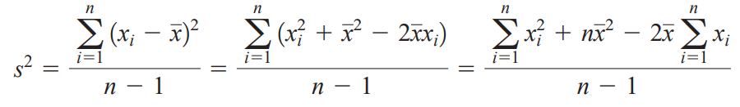
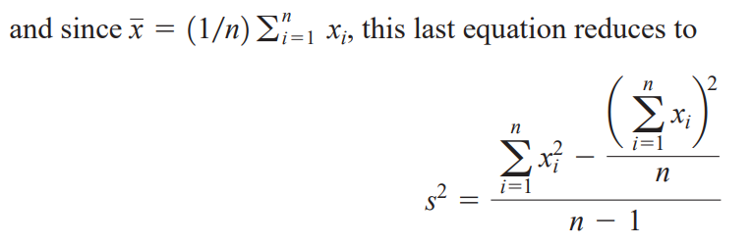
Sample Variance - Note

Slide 10
Exercise
(Ex.6-38) The female students in an undergraduate engineering core course at ASU self-reported their heights to the nearest inch. The data follow. Calculate the sample variance and standard deviation.
62 64 61 67 65 68 61 65 60 65 64 63 59 68 64 66 68 69 65 67 62 66 68 67 66 65 69 65 69 65 67 67 65 63 64 67 65
---
The sample variance is s² = 6.47
The standard deviation is s = 2.54
Notes:
x<-c(62, 64, 61, 67, 65, 68, 61, 65, 60, 65, 64, 63, 59, 68, 64, 66, 68, 69, 65, 67, 62, 66, 68, 67, 66, 65, 69, 65, 69, 65, 67, 67, 65, 63, 64, 67, 65)

Slide 11
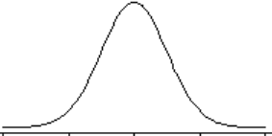
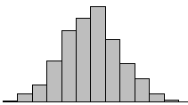
Relationship between a population and a sample
Sample mean‾x, variance s²
σ²
Sample
(x₁, x₂, …, x_{n})
μ
‾x
Probability distribution of Population
Histogram of sample

Slide 12
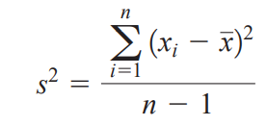
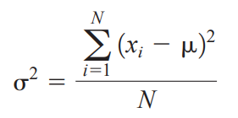
Sample Variance vs Population Variance
The sample variance
The population variance

Slide 13
Numerical summaries – Ex
A network provider investigates the load of its network. The number of concurrent users is recorded at ten locations (thousands of people),
17.2, 22.1, 18.5, 17.2, 18.6, 14.8, 21.7, 15.8, 16.3, 22.8
Compute the sample mean, variance, and standard deviation of the number of concurrent users.
---
Sample mean:‾x = 18.5 (thousands of people)
Sample variance s² = 7.88
Sample standard deviation: s = 2.81 (thousands of people)

Slide 14
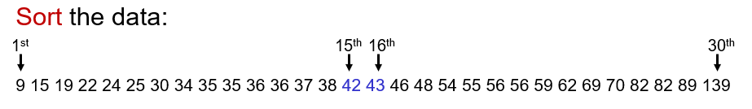
Sample median - Example
Ex. (Median CPU time).
Since n = 30, (n + 1)/2 = 15.5 ➔ consider the 15-th smallest and 16-th smallest observations.
➔ (42 + 43)/2 = 42.5 the sample median

Slide 15
Exercise
(Ex.6-38) The female students in an undergraduate engineering core course at ASU self-reported their heights to the nearest inch. The data follow. Calculate the sample median of height.
62 64 61 67 65 68 61 65 60 65 64 63 59 68 64 66 68 69 65 67 62 66 68 67 66 65 69 65 69 65 67 67 65 63 64 67 65
---
Sort the data
59 60 61 61 62 62 63 63 64 64 64 64 65 65 65 65 65 65 65 65 65 66 66 66 67 67 67 67 67 67 68 68 68 68 69 69 69
n = 37 is odd and (n + 1)/2 = 19
➔ The 19th smallest observation = 65 is the sample median
Notes:
x<-c(62, 64, 61, 67, 65, 68, 61, 65, 60, 65, 64, 63, 59, 68, 64, 66, 68, 69, 65, 67, 62, 66, 68, 67, 66, 65, 69, 65, 69, 65, 67, 67, 65, 63, 64, 67, 65)

Slide 16
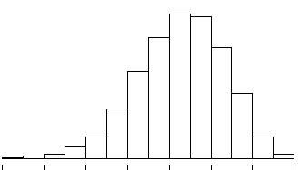
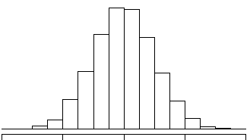
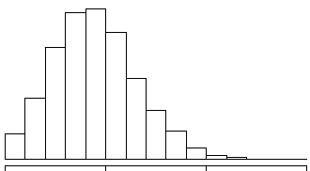
Mean vs medium
Mean < Medium Medium = Mean Medium < Mean
Left-skewed Symmetric Right-skewed
Negative skew Positive skew

Slide 17
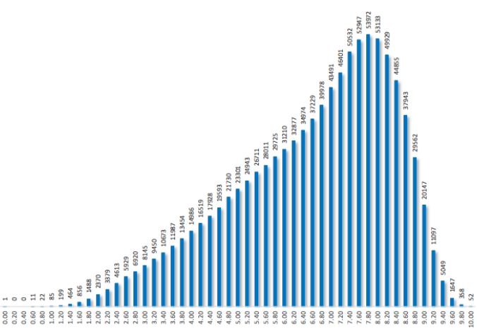
Mean vs Medium – Ex
Math Scores on National High School Exam in 2021
Negative or left Skew:
Mean = 6.61 < 7.0 = Medium

Slide 18
Quantiles, quartiles, percentiles
A 100kth percentile is a value x such that
P{X  x} ≈ k
P{X  x} ≈ 1 – k
Special cases of 100kth percentile
k = 0.25: first quartile, 25th percentile = q₁
k = 0.5: second quartile, 50th percentile = q₂ = median
k = 0.75: third quartile, 75th percentile = q₃
The interquartile range, IQR = q₃ – q₁
|
x
P{ X  x } ≈ k
P{ X  x } ≈ 1 – k

Slide 19
Quantiles, quartiles, percentiles - Ex
> sort(CPUtime)
[1] 9 15 19 22 24 25 30 34 35 35 36 36 37 38 42 43 46
[18] 48 54 55 56 56 59 62 69 70 82 82 89 139
1st quartile: (n +1)/4 = 31/4 = 7.75 ➔ between 7th and 8th observations: 33.5
3rd quartile: 3(n+1)/4 = 23.25 ➔ between 23rd and 24th observations: 59.5
q₁ = 33.5 and q₃ = 59.5
IQR = q₃ – q₁ = 59.5 – 33.5 = 26
Notes:
# In R
quantile(x, probs = c(0, 0.25, 0.43)) # will return the smallest observation, the first quartile, q₁, and the 43th sample quantile

Slide 20
Quantiles – Note
> sort(CPUtime)
[1] 9 15 19 22 24 25 30 34 35 35 36 36 37 38 42 43 46
[18] 48 54 55 56 56 59 62 69 70 82 82 89 139
> quantile(CPUtime, probs = c(0, 0.1,0.25, 0.3, 0.5,0.75,0.95, 1), type=1)
0% 10% 25% 30% 50% 75% 95% 100%
9 19 34 35 42 59 89 139
> quantile(CPUtime, probs = c(0, 0.1,0.25, 0.3, 0.5,0.75,0.95, 1), type=7)
0% 10% 25% 30% 50% 75% 95% 100%
9.00 21.70 34.25 35.00 42.50 58.25 85.85 139.00

Slide 21
Exercise
(Ex.6-38) The female students in an undergraduate engineering core course at ASU self-reported their heights to the nearest inch. The sorted data follow. Calculate the quartiles q₁, q₂, q₃.
59 60 61 61 62 62 63 63 64 64 64 64 65 65 65 65 65 65 65 65 65 66 66 66 67 67 67 67 67 67 68 68 68 68 69 69 69
---
n = 37, (n+1)/4 = 9.5, 2(n+1)/4 = 19, 3(n+1)/4 = 28.5
q₁ = 64
q₃ = 67

Slide 22
Sample range
Sample range r = max(x_{i}) – min(x_{i})
> sort(CPUtime)
[1] 9 15 19 22 24 25 30 34 35 35 36 36 37 38 42 43 46
[18] 48 54 55 56 56 59 62 69 70 82 82 89 139
➔ r = max(x_{i}) – min(x_{i}) = 139 – 9 = 130

Slide 23
Stem-and-leaf diagrams
Each number in the data point x₁, x₂, …, x_{n} consists of at least two digits
Steps to construct stem-and leaf diagram
(1) divide each x_{i} into two parts: a stem: one or more of leading digits; and a leaf: the remaining digit
(2) List the stem values in a vertical
(3) Record the leaf beside its stem
(4) Write the units for stems and leaves
24
29
27
Stem | Leaf
2 | 479

Slide 24
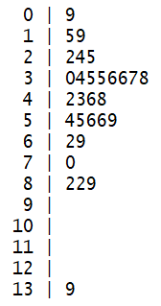
Stem-and-leaf diagrams - Ex
(CPU time) 70 36 43 69 82 48 34 62 35 15 59 139 46 37 42 30 55 56 36 82 38 89 54 25 35 24 22 9 56 19
Stem Leaf
2
4
5
2
22, 24, 25
Stem: tens and hundreds
Leaf: Ones digits
Stem Leaf Data values

Slide 25
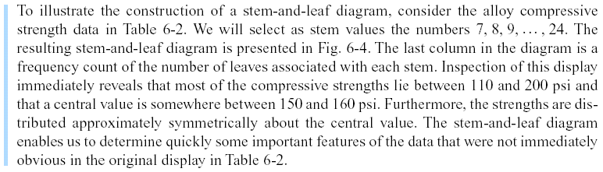

Slide 26
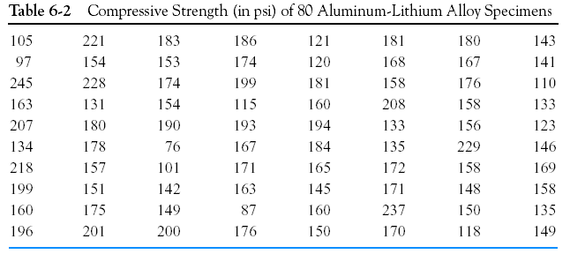

Slide 28
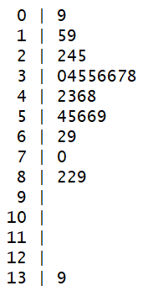
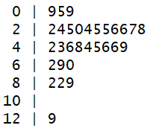
Stem-and-leaf diagrams – Ex
(CPU time)
9 15 19 22 24 25 30 34 35 35 36 36 37 38 42 43 46
48 54 55 56 56 59 62 69 70 82 82 89 139
7 stems
If we use too many stems in a plot, the resulting in a display that may not tell us much about the shape of the data
14 stems

Slide 29
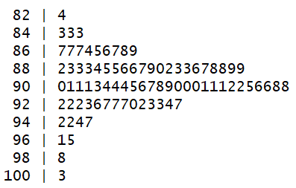
Stem-and-leaf diagrams - Ex
An article in Technometrics (1977, Vol. 19, p. 425) presented the following data on the motor fuel octane ratings of several blends of gasoline:
(n = 82 observations)
83.4 84.3 84.3 85.3 86.7 86.7 86.7 87.4 87.5 87.6 87.7 87.8 87.9 88.2 88.3 88.3 88.3 88.4 88.5 88.5 88.6 88.6 88.7 88.9 89.0 89.2 89.3 89.3 89.6 89.7 89.8 89.8 89.9 89.9 90.0 90.1 90.1 90.1 90.3 90.4 90.4 90.4 90.5 90.6 90.7 90.8 90.9 91.0 91.0 91.0 91.1 91.1 91.1 91.2 91.2 91.5 91.6 91.6 91.8 91.8 92.2 92.2 92.2 92.3 92.6 92.7 92.7 92.7 93.0 93.2 93.3 93.3 93.4 93.7 94.2 94.2 94.4 94.7 96.1 96.5 98.8 100.3
an informative visual display
The decimal point is at |
Notes:
x<-c(88.5, 98.8, 89.6, 92.2, 92.7, 88.4, 87.5, 90.9, 94.7, 88.3, 90.4, 83.4, 87.9, 92.6, 87.8, 89.9, 84.3, 90.4, 91.6, 91.0, 93.0, 93.7, 88.3, 91.8, 90.1, 91.2, 90.7, 88.2, 94.4, 96.5, 89.2, 89.7, 89.0, 90.6, 88.6, 88.5, 90.4, 84.3, 92.3, 92.2, 89.8, 92.2, 88.3, 93.3, 91.2, 93.2, 88.9, 91.6, 87.7, 94.2, 87.4, 86.7, 88.6, 89.8, 90.3, 91.1, 85.3, 91.1, 94.2, 88.7, 92.7, 90.0, 86.7, 90.1, 90.5, 90.8, 92.7, 93.3, 91.5, 93.4,89.3, 100.3, 90.1, 89.3, 86.7, 89.9, 96.1, 91.1, 87.6, 91.8, 91.0, 91.0)

Slide 30
Frequency Distributions and Histograms
Frequency Distributions
More compact than a stem-and-leaf diagram
The range of the data is divided into intervals (class intervals, cells, bins)
A frequency histogram consists of columns, one for each bin, whose height is determined by the number of observations in the bin.
A relative frequency histogram has the same shape but a different vertical scale. Its column heights represent the proportion of all data that appeared in each bin.

Slide 31
Histograms
The histogram is a visual display of the frequency distribution.
Histograms are stable and reliable for large data sets, preferably of size 75 to 100 or more.
Constructing a Histogram (Equal Bin Widths)
(1) Label the bin boundaries on a horizontal scale
(2) Mark and label the vertical scale with the (relative) frequencies
(3) Above each bin, draw a rectangle where height is equal to the (relative) frequency corresponding to that bin

Slide 32
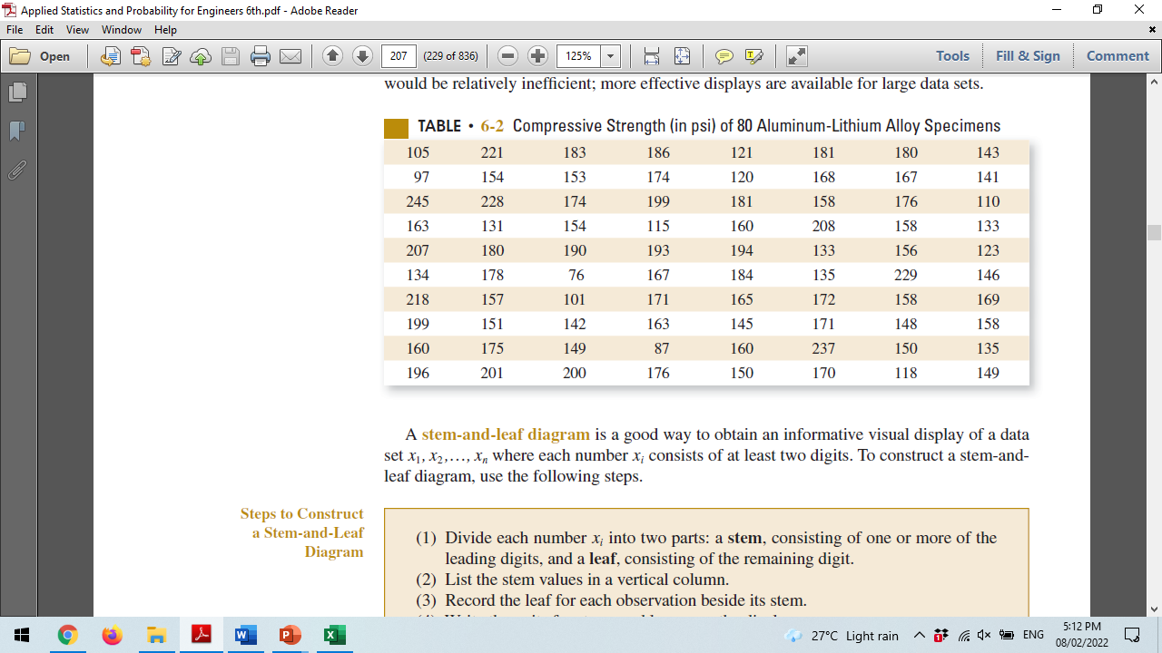

Slide 33
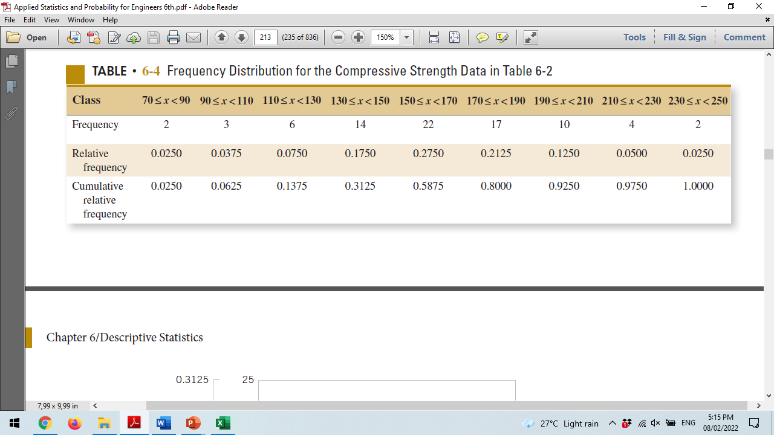

Slide 34
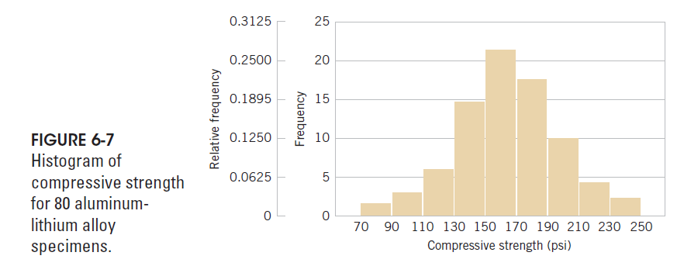

Slide 35
Histogram - Ex
Ex. (CPU time) 70 36 43 69 82 48 34 62 35 15 59 139 46 37 42 30 55 56 36 82 38 89 54 25 35 24 22 9 56 19
Choosing intervals [0,10), [10,20), [20, 30), . . . as bins, we count
1 observation in [0, 10)
2 observations in [10, 20)
3 observations in [20, 30)
. . . . . . . . . . . .

Slide 36
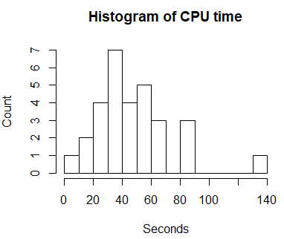
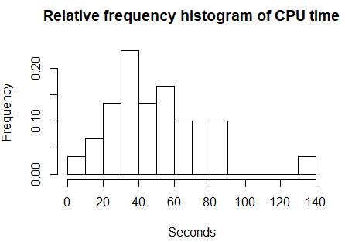
Ex. Histogram of CPU time data
Some information can be drawn from the histograms:
- Distribution of CPU times is not symmetric; it is right-skewed as we see 5 columns to the right of the highest column and only 3 columns to the left.
- The time of 139 seconds stands alone suggesting that it is in fact an outlier.
Notes:
z<-c(70, 36, 43, 69, 82, 48, 34, 62, 35, 15, 59, 139, 46, 37, 42, 30, 55, 56, 36, 82, 38, 89, 54, 25, 35, 24, 22, 9, 56, 19)
hist(z,breaks=14,main='Histogram of CPU time',ylab='Count',xlab='Seconds',freq=T)
(density(z))
h<-hist(z,breaks=14,plot=F)
h$counts<-h$counts/sum(h$counts)
plot(h,freq=TRUE,xlab='Seconds',ylab='Frequency',main='Relative frequency histogram of CPU time')

Slide 37
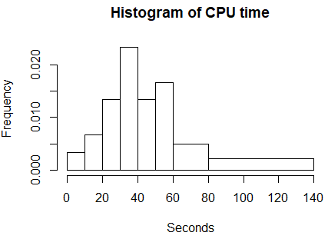
Histogram
With unequal bins,
Unequal bins

Slide 38
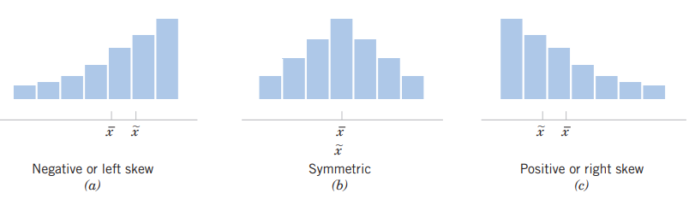
Histograms for symmetric and skewed distributions
Usually, we find that
if mode < median < mean, the distribution is right-skewed
if mode > median > mean, the distribution is left-skewed

Slide 39
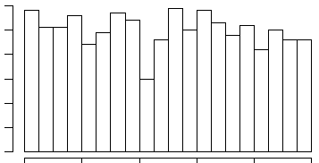
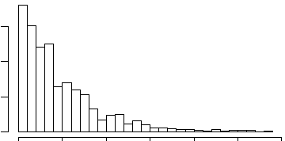
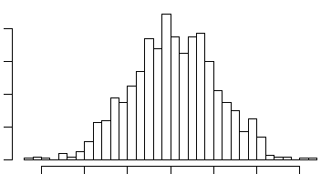
Histograms of various samples
Uniform distribution
Exponential distribution
Normal distribution
Notes:
hist(rexp(1000,2),breaks=30)

Slide 40
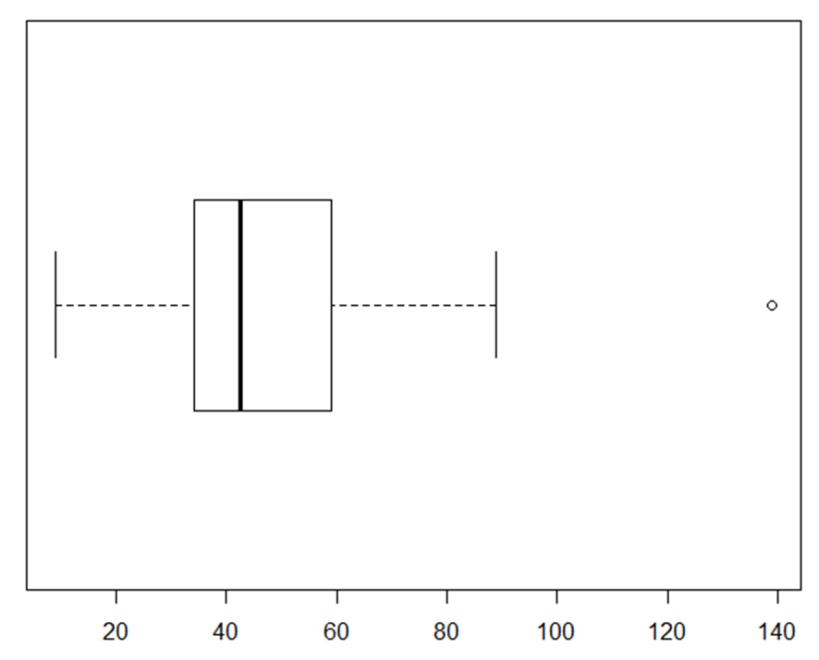
Box plot
The box plot is a graphical display that simultaneously describes several important features of a data set:
Center
Spread
Symmetry
Outlier
Extreme outlier

Slide 41
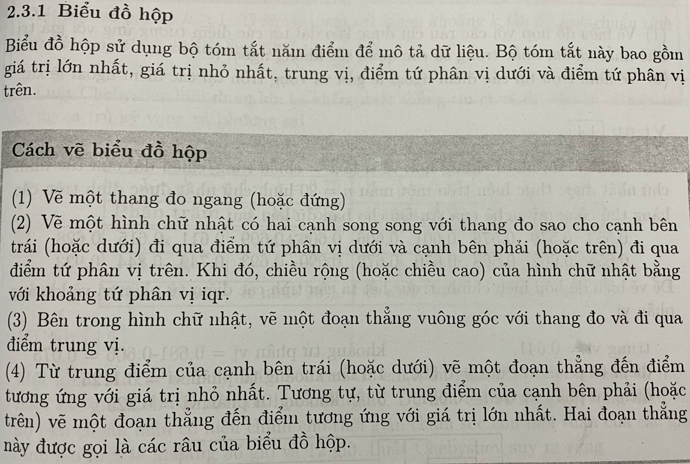

Slide 42
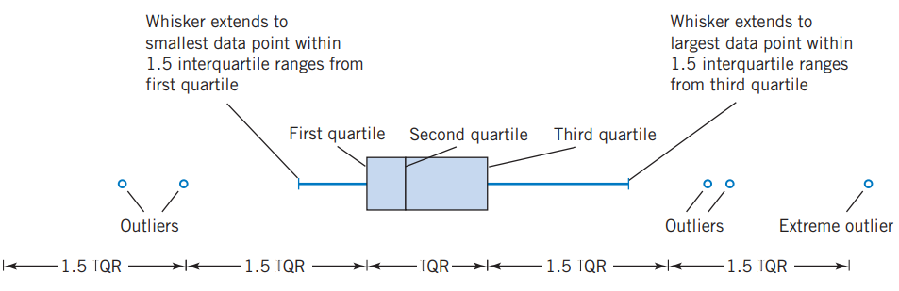
Description of a box plot
Five-point summary = (min(x_{i}), q₁, q₂, q₃, max(x_{i}))

Slide 43

Ex – CPU time Box plot
> sort(CPU time)
[1] 9 15 19 22 24 25 30 34 35 35 36 36 37 38 42 43 46
[18] 48 54 55 56 56 59 62 69 70 82 82 89 139
Upper whisker = 89
outlier = 139
IQR = q₃ – q₁ = 59.5 – 33.5 = 26
1.5IQR = 39
q₃ + 1.5IQR
= 59.5 + 39 = 98.5
Upper whisker is 89
98.5 + 1.5IQR = 137.5
➔ 139 is the extreme outlier
Lower whisker = 9
q₁
q₂
q₃
1.5IQR 1.5IQR IQR 1.5IQR 1.5IQR

Slide 44
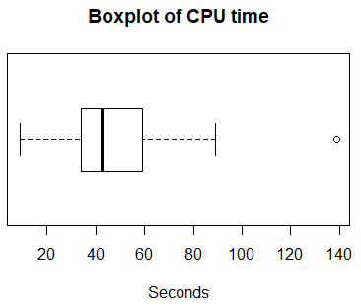
CPU time Ex – Histogram vs Boxplot

Slide 45
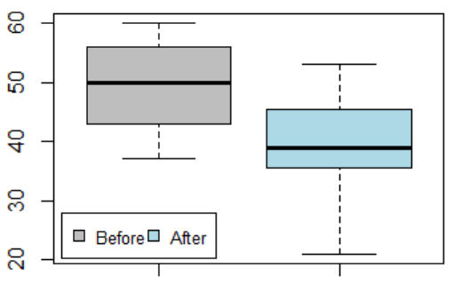
Comparative box plots
Ex. The numbers of blocked intrusion attempts on each day during the first two weeks of the month were 56, 47, 49, 37, 38, 60, 50, 43, 43, 59, 50, 56, 54, 58. After the change of firewall settings, the numbers of blocked intrusions during the next 20 days were 53, 21, 32, 49, 45, 38, 44, 33, 32, 43, 53, 46, 36, 48, 39, 35, 37, 36, 39, 45.
Parallel boxplots
Notes:
# In R
x1<-c(56, 47, 49, 37, 38, 60, 50, 43, 43, 59, 50, 56, 54, 58)
x2<-c(53, 21, 32, 49, 45, 38, 44, 33, 32, 43, 53, 46, 36, 48, 39, 35, 37, 36, 39, 45)
boxplot(x1,x2,ylab="Blocked intrusion attempts",col=c('red','blue'))
legend("bottomleft",inset=.02, c("Before","After"),fill=c('red','blue'), horiz=TRUE, cex=0.8)

Slide 46
Time Sequence Plots
A time series or time sequence is a data set in which the observations are recorded in the order in which they occur.
A time series plot
the vertical axis denotes the observed value
the horizontal axis denotes the time
In a time series plot, we often see
trends,
cycles,
or other broad features of the data

Slide 47
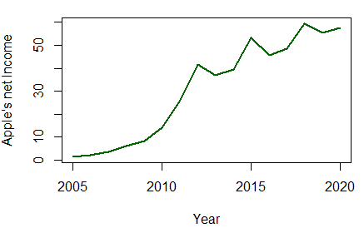
Ex- Apple’s net Income (2005 - 2020)
Year Income (B)
2005 1.33
2006 1.99
2007 3.5
2008 6.12
2009 8.24
2010 14.01
2011 25.92
2012 41.73
2013 37.04
2014 39.51
2015 53.39
2016 45.69
2017 48.35
2018 59.53
2019 55.26
2020 57.41
A time series plot of the annual income of Apple (2005-2020).
The general impression from this display is that incomes show an upward trend.
Notes:
# In R
ap<-c(1.33,1.99,3.5,6.12,8.24,14.01,25.92,41.73,37.04,39.51,53.39,45.69,48.35,59.53,55.26,57.41)
apts<-ts(ap,start=2005)
str(apts)
plot.ts(apts,ylab = "Apple's net Income",xlab="Year",col="blue",lwd=2)

Slide 48
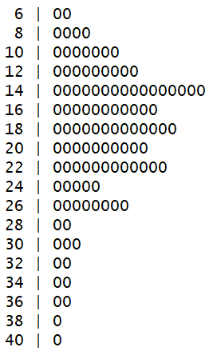
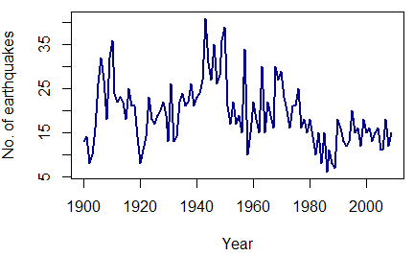
The number of earthquakes per year of magnitude 7.0 and higher (1900-2009)
13, 14, 8, 10, 16, 26, 32, 27, 18, 32, 36, 24, 22, 23, 22, 18, 25, 21, 21, 14, 8, 11, 14, 23, 18, 17, 19, 20, 22, 19, 13, 26, 13, 14, 22, 24, 21, 22, 26, 21, 23, 24, 27, 41, 31, 27, 35, 26, 28, 36, 39, 21, 17, 22, 17, 19, 15, 34, 10, 15, 22, 18, 15, 30, 15, 22, 19, 16, 30, 27, 29, 23, 20, 16, 21, 21, 25, 16, 18, 15, 18, 14, 10, 15, 8, 15, 6, 11, 8, 7, 18, 16, 13, 12, 13, 20, 15, 16, 12, 18, 15, 16, 13, 15, 16, 11, 11, 18, 12, 15
The decimal point is at the |
Notes:
eq<-c(13, 14, 8, 10, 16, 26, 32, 27, 18, 32, 36, 24, 22, 23, 22, 18, 25, 21, 21, 14, 8, 11, 14, 23, 18, 17, 19, 20,
22, 19, 13, 26, 13, 14, 22, 24, 21, 22, 26, 21, 23, 24, 27, 41, 31, 27, 35, 26, 28, 36, 39, 21, 17, 22, 17, 19,
15, 34, 10, 15, 22, 18, 15, 30, 15, 22, 19, 16, 30, 27, 29, 23, 20, 16, 21, 21, 25, 16, 18, 15, 18, 14, 10, 15,
8, 15, 6, 11, 8, 7, 18, 16, 13, 12, 13, 20, 15, 16, 12, 18, 15, 16, 13, 15, 16, 11, 11, 18, 12, 15)
eqts<-ts(eq,start=1900)
str(eqts)
plot.ts(eqts,ylab = "No. of earthquakes",xlab="Year",col="dark blue",lwd=2)

Slide 49
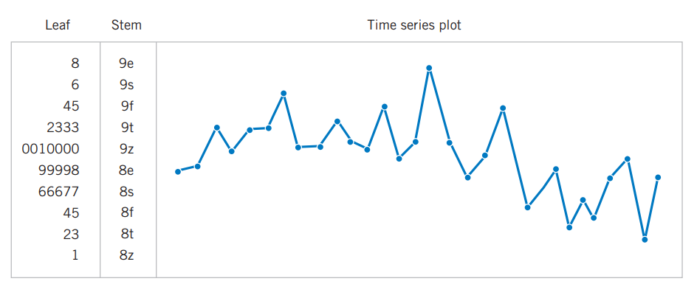
The digidot plot

Slide 50
Summary
Summaries of data
Central
Mean
Median
Mode
Spread of data
Variance
Standard deviation
Range
Quantiles, quartiles
Graphics
Stem-and-leaf diagrams,
Histograms
Box plot
Time series plots.

Slide 51
Exercises
(13x + 17) mod 87
(11x + 21) mod 87
(9x + 29) mod 87

